Slide 1


Nick Jones
CEO and Registrar

Slide 2

25 August 2021
Event
Outcomes
A greater understanding of the GCC
A greater understanding of how the GCC carries out its regulatory duties
Understand issues facing the profession in the near future
Opportunity to comment and query on GCC strategy

Slide 3
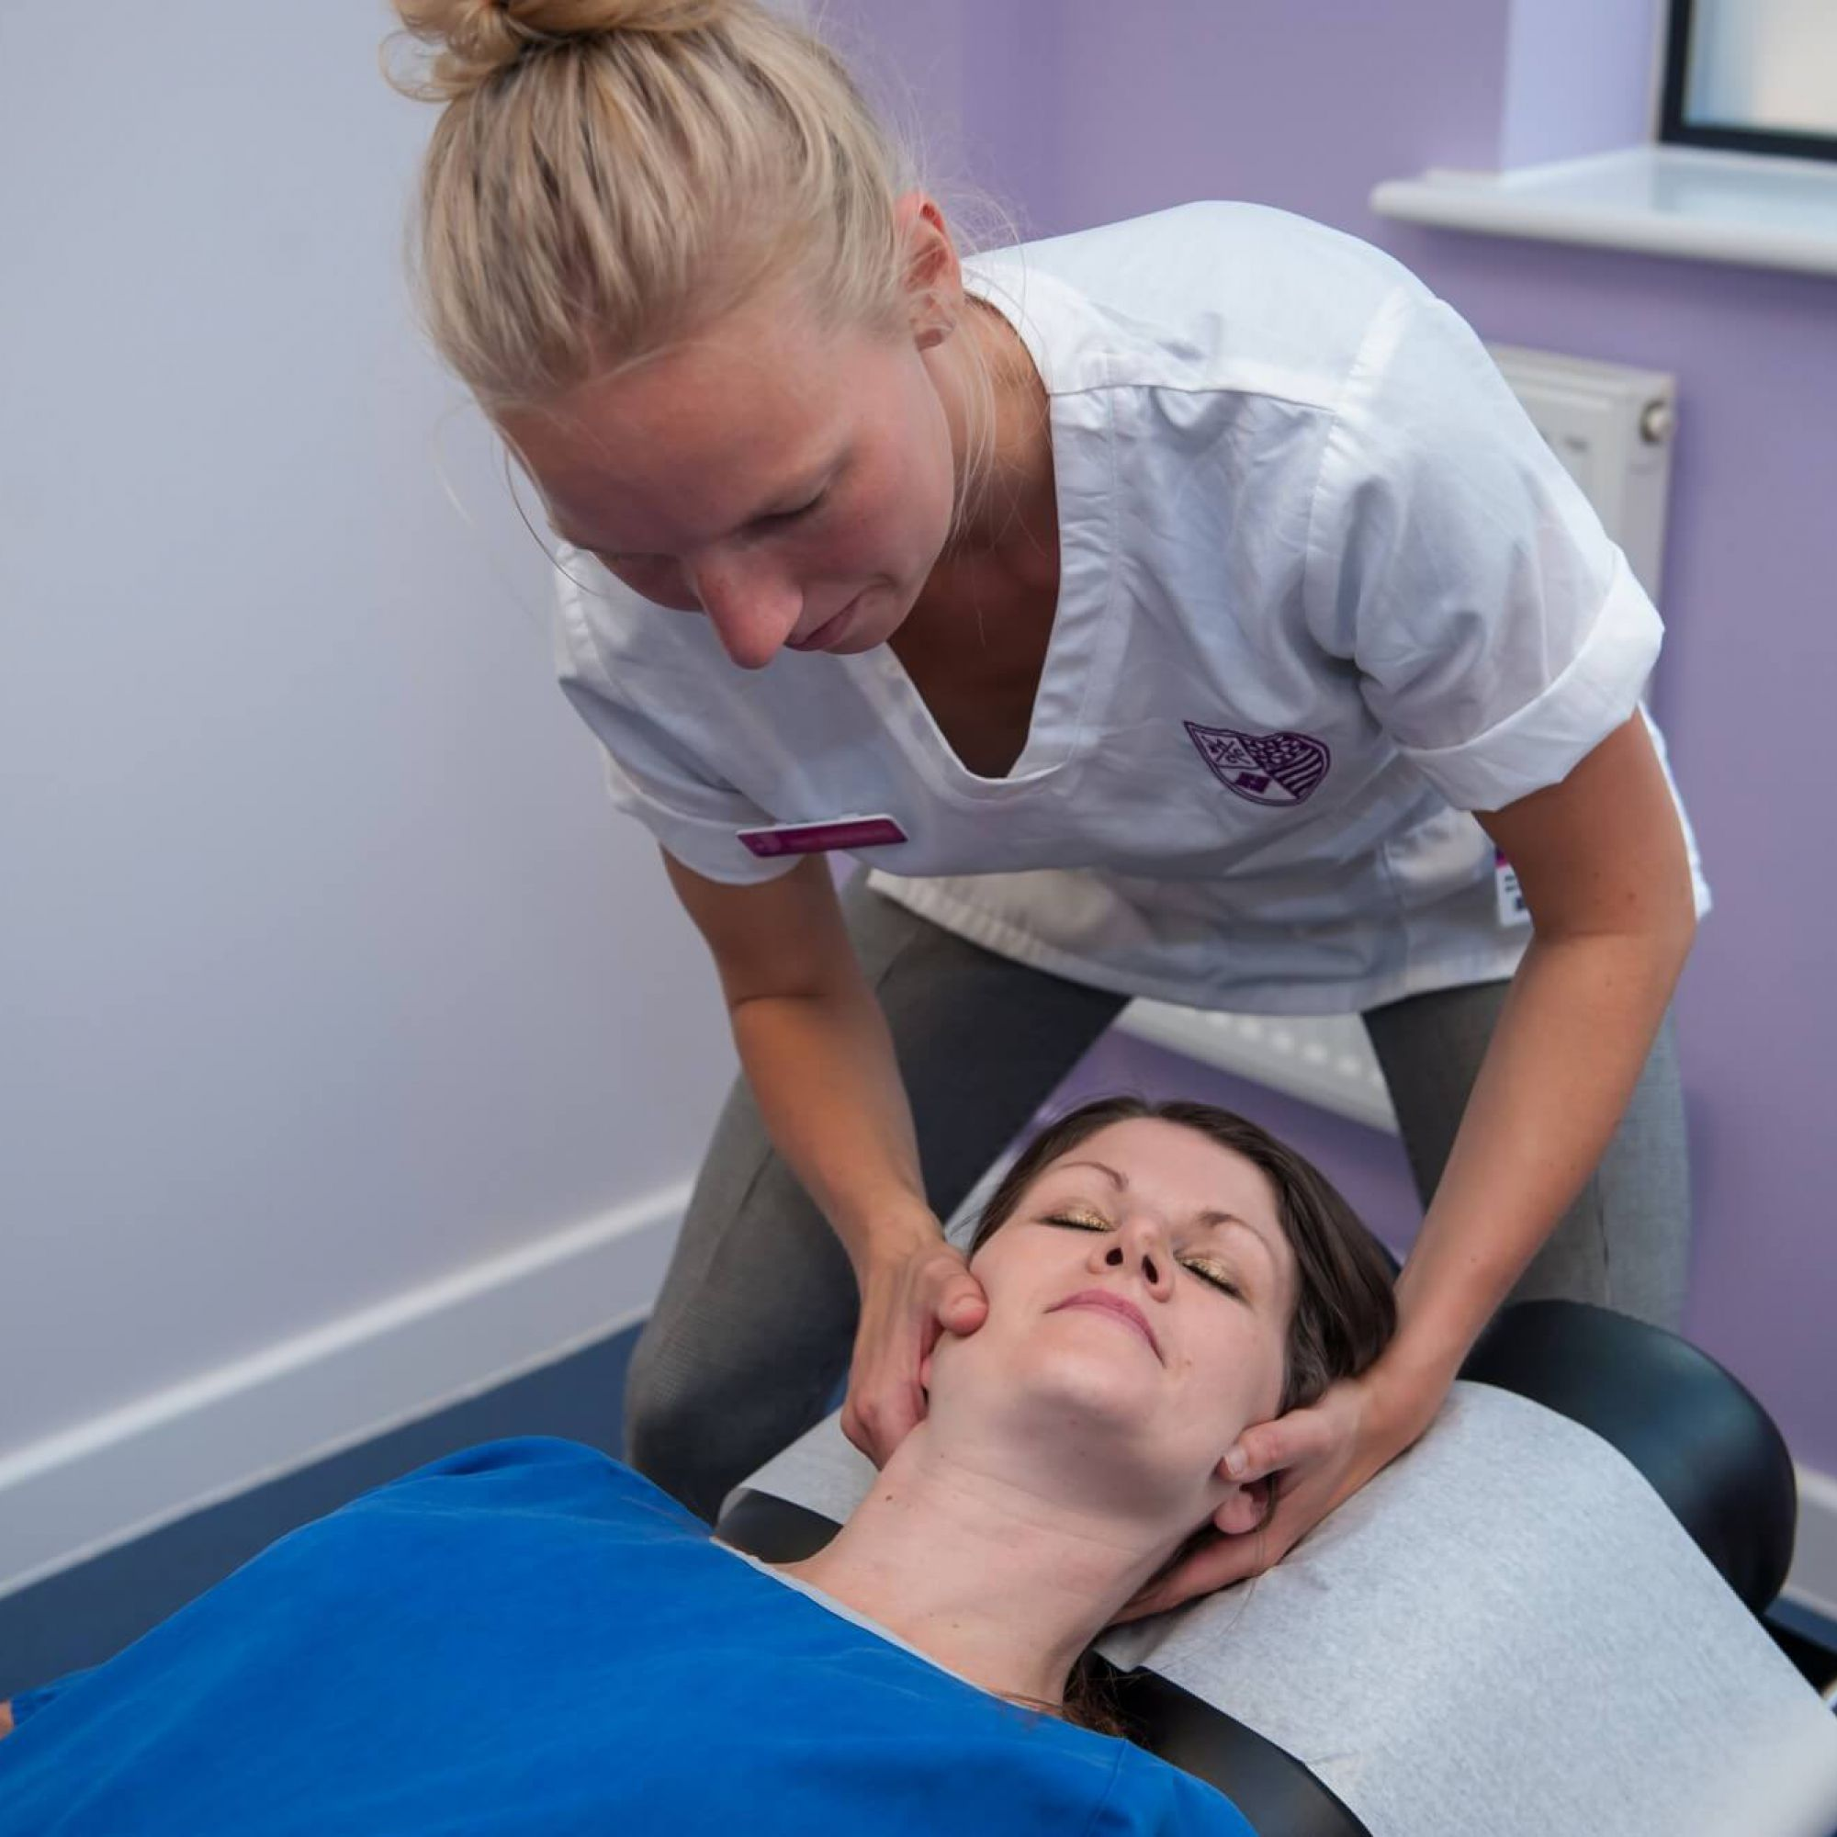
  What is our function
  A developing profession
  Covid-19
The profession:
Today

Slide 4

  Future of regulators
  Impact on chiropractic
  Future proofing
The profession:
2022 and beyond
The profession:
2022 and beyond

Slide 5

Aim One
“To place patients and their expectations of care at the centre of all GCC work.”
Aim Two
“To promote chiropractic excellence, professionalism and value within the health and care system.”
Aim Three
“To regulate effectively, efficiently, innovatively and inclusively.”
Aim Four
“To enhance the nature and form of regulation for the profession for the future.”
GCC Strategy 2022-2024
YOUR VIEWS COUNT

Slide 6
“To place patients and their expectations of care at the centre of all GCC work.”
Patients &
Public:
Objectives:
1A
To gain a greater understanding of patients’ needs and expectations so these can be reflected in the work of the GCC.
1B
To promote and enforce standards that take full account of patients’ needs and legitimate expectations.
1C
To enhance the information the GCC provides to help patients make better informed judgements about their chiropractic care.

Slide 7
“To promote chiropractic excellence, professionalism and value within the health and care system.”
Chiropractors:
Objectives:
2A
2B
2C
To identify, collect and analyse data and insights from regulatory and statutory activity.
To share learning through the gathering and dissemination of GCC internal data and public, patient and registrant research.
To work with education providers and stakeholders to develop and promote professionalism in registrants from the start to end of their careers.

Slide 8
“To regulate effectively, efficiently, innovatively and inclusively.”
The GCC:
Objectives:
To set and promote educational, professional and registration requirements that are appropriate and fit for purpose.
3A
3B
To take appropriate and measured action on complaints, the misuse of title, or when registration requirements, including annual CPD fulfilment, are not met.
3C
To be a sustainable and effective organisation committed to equality, diversity and fairness.

Slide 9
“To enhance the nature and form of regulation for the profession for the future.”
The Profession:
Objectives:
To ‘shape the future’ of regulation of the profession by influencing the conclusions of the DHSC consultation and review of health and care regulation.
4B
4C
4A
To foster knowledge sharing and expertise, drive efficiencies and seek opportunities to delegate and/or attain economies of scale.
To take forward the development of rules to be applied upon agreed legislative change.

Slide 10
Of interest to the GCC (in no particular order):
  Independent regulator or merged into a multi-discipline regulator?
  What would you like to see or hear from the GCC?
  Would you like to see an expansion of courses to grow the profession?
  Our relationship with the NHS (closer or as is?)
  Do you believe chiropractic to be a divided profession?
  Your overall views of the GCC (good and bad)
We want to hear from you
enquiries@gcc-uk.org

Slide 11
Nick Jones
CEO and Registrar

